Slide 1
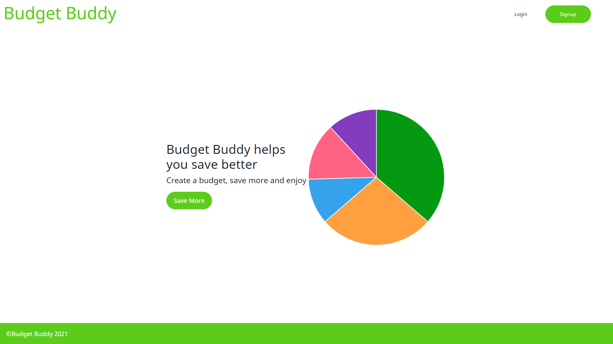
Budget Buddy

Slide 2
Tired of Living Paycheck to Paycheck?
Nearly 70 percent of Americans have less than $1,000 stashed away and 45 percent have nothing saved.
Budget Buddy will visualize where all of your money is going so you can save more.
Next cut down spending where you can
Keep track of your savings

Slide 3
Concept
A budgeting app that visualizes a person's spending so that they can keep track of their spending
I wanted to be able to easily keep track of what I am spending my money on so that I invest more of my money
User Story - The user will login to their profile where they can see there monthly income and a list of their monthly transactions. They can add transactions and edit them in their profile. A pie chart will also be provided for a visual representation of the users budget.

Slide 4
Process
HTML, CSS, JS, ExpressJS, MYSQL, ChartJS, AnimeJS
Sarita - Models
Sam - Handlebars
Kevin - API Routes
Dominic - Chart, Design/Animation
Challenges - A lot to keep track of. Handlebars is tough to work with.
Successes - It works and it looks good c:

Slide 5
Demo

Slide 6
Directions for Future Development
Keeps track
Change Budget Length
Call transaction by date
Recurring transactions
Visualize Monthly Spending

Slide 7
Links
https://infinite-sea-98511.herokuapp.com/
https://github.com/smaheilman/Budget-buddy

